Slide 1
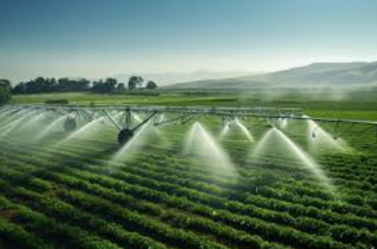
Arduino Based Automatic Irrigation System
Presented By:
O. Chandrika (21481A04G8)
L.Vijay Kumar (21481A04D2)
M.Srinivas (21481A04E4)
B.Leena (20481A0436)

Slide 2
TABLE OF CONTENTS
Introduction
Components Required
Circuit Diagram
Flowchart
Working Principle
Applications
Advantages and Disadvantages
Result
Conclusion

Slide 3
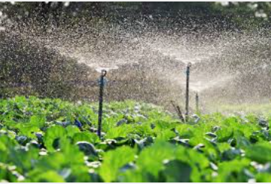
Introduction
Irrigation is the artificial application of the land or soil.
Knowing when and how much to water is two important aspects of watering process.
To make farming works easily, the automatic irrigation is created.
To impress the farmers for using renewable energy.

Slide 4
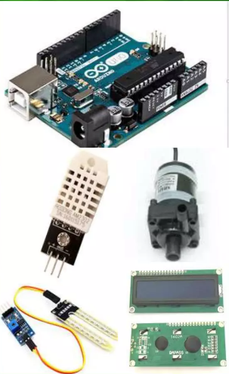
Components required
Arduino Uno -1
Soil Moisture Sensor -1
Resistors -1kohm -1
Potentiometer – 1kohm – 2
Inductor – 27uH – 1
Capacitor – 100uf – 1
Temperature sensor(LM 35) – 1
Relay – 1
Transistor(BC547) – 1
Motor – 1
16x2 Alphanumeric LED Display
Water level sensor - 1

Slide 5
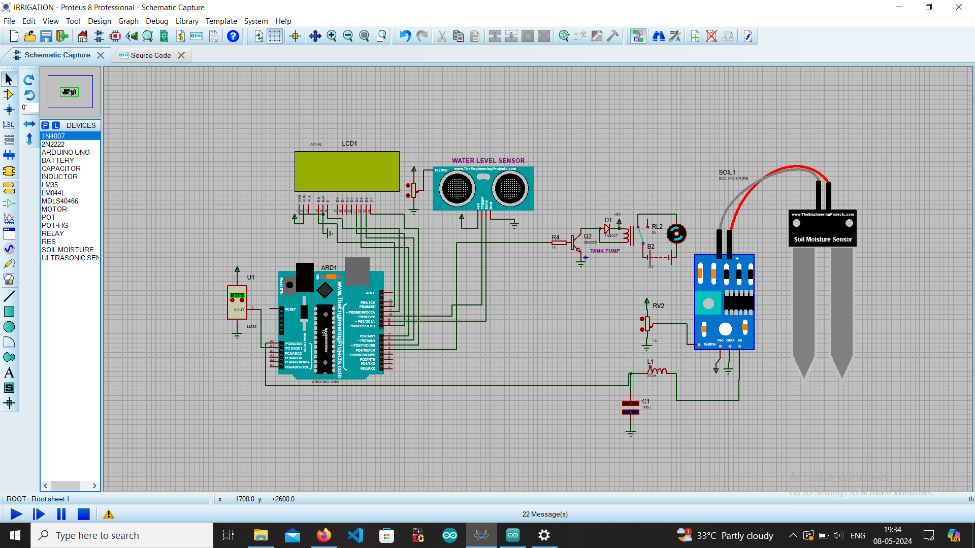
Circuit diagram

Slide 6
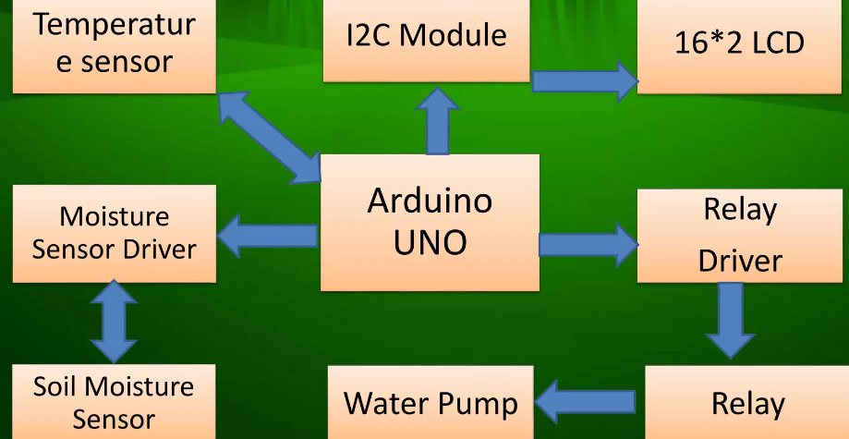
Flow chart

Slide 7
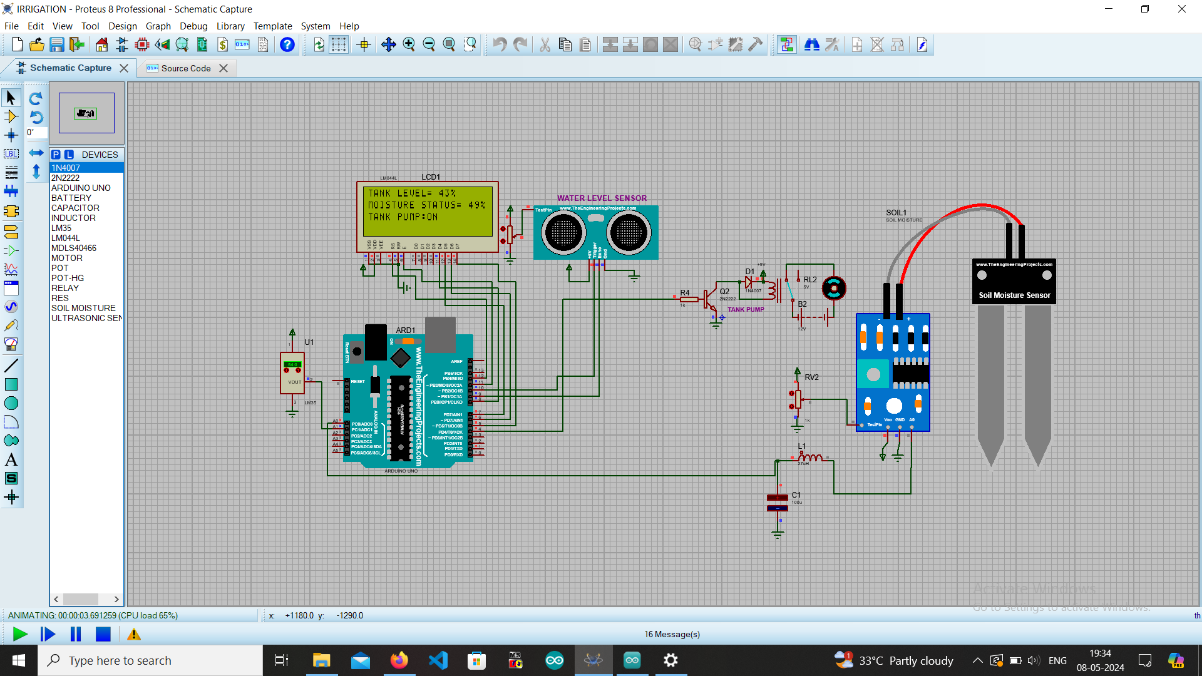
Working principle
The soil moisture sensor module is connected to the Arduino Uno board. The module has three pins: VCC, GND, and AO (analog output).
VCC and GND are connected to 5V and GND pins of the Arduino board, respectively.
The AO pin is connected to an analog input pin of the Arduino board (such as A0).

Slide 8
The relay module is also connected to the Arduino board. The module has three pins: VCC, GND, and IN. VCC and GND are connected to 5V and GND pins of the Arduino board, respectively. The IN pin is connected to a digital output pin of the Arduino board (such as pin 7).
When the soil moisture level is below a certain threshold (determined by the code), the voltage output of the soil moisture sensor module increases. The Arduino reads this voltage using the analog input pin and compares it with the threshold value.
If the value is below the threshold, the Arduino sends a signal to the relay module through the digital output pin to activate the water pump. The water pump is connected to the relay module. When the relay module receives a signal from the Arduino, it switches on the water pump. The pump starts irrigating the plants until the soil moisture level reaches the desired level.
Once the desired level is reached, the Arduino turns off the pump by sending a signal to the relay module.
Overall, this circuit ensures that the plants are watered only when the soil moisture level is below the desired level, saving water and ensuring optimal plant growth.

Slide 9
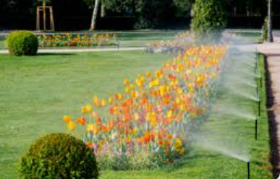
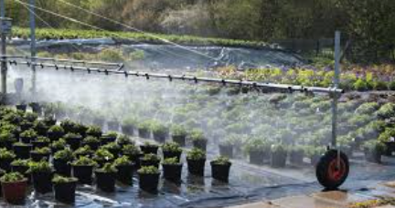
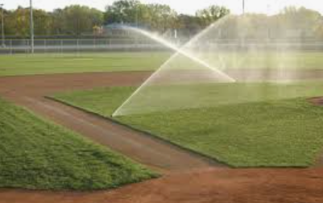
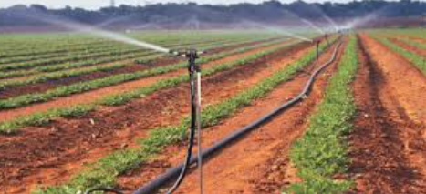
Applications
Public Parks: Manages irrigation for lawns, flower beds, and trees in parks and recreational areas, ensuring they remain green and healthy.
Plant Nurseries: Helps manage watering for a variety of plants, from seedlings to mature specimens, supporting plant health and growth.
Sports Fields: Provides even and controlled watering for sports fields to maintain safe playing surfaces.
Agricultural Research: Supports research on plant growth, water usage, and environmental effects by providing precise and consistent irrigation.

Slide 10
Advantages
Disadvantages
Save time- reduces the time spent on irrigating by yourself / labours.
Save money – no need to waste money on labours.
Save water – helps in places where there is shortage of water.
Increase soil fertility - water will not evaporates quickly.
The systems are too expensive.
It uses a lot of electricity.
Sometimes it may fail to work.
More labours whon worked as gardeners were left jobless.

Slide 11
Result
To measure the temperature, the Temperature sensor measures and send signal in Arduino.
To measure the level of soil, the Moisture sensor senses and send signal in Arduino.
To control Relay with Motor, Arduino is used. It is programmed by Arduino IDE.
Finally the pump supply the water to the water ,until the desired moisture level is reached.

Slide 12
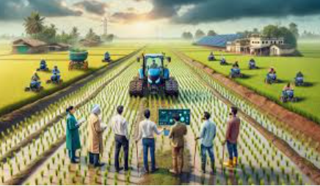
Conclusion
In present days especially farmers are facing major problems in watering their agriculture field. Because they have proper idea about when the power is available so that they can pump water. even after then they need to wait until the field is properly watered, which makes them to stop other activities.
Here is an idea which helps not only farmers even for watering garden also, which senses soil moisture and switches the valve automatically when the power is on.

Slide 13
Thank you

